Slide 1
Travello - Online Tour Booking Website
Enhancing Travel Experience with Seamless Booking

Slide 2
Name:- Vyom Rana
Roll No:- CE133
ID:- 20CEUBS046
Sem:- 8th
Branch:- Computer Engineering
Internal Guide:-
Bhavika M. Gambhava
Associate Professor
Dept.of Comp. Engg

Slide 3
Tables of Content
Table | Summary
Introduction To Travello | Objectives and Technology Used
Framework Features | Functionalities of Frameworks implemented.
Naive User Functionalities | Working of normal user ‘s features.
Admin User Functionalities | Working of Admin user ‘s features.
Future Enhancement | Future Improvements in the project
Conclusion | Outcome of development of project.
Links & References | References used to make project.

Slide 4
Introduction to Travello
Travello is an online tour booking website aimed at providing a seamless booking experience and performance optimized solution for Travelers and Tour Selling companies.
It leverages modern technologies such as
MongoDB
ExpressJS
ReactJS
NodeJS
JWT API
Razorpay API
Weather API
QR Code
And many other internal libraries of frameworks.

Slide 5
Framework Features
Travello incorporates the following framework features:
Creating a responsive user interface ensures compatibility across all devices.
Lazy loading implementation optimizes performance by loading resources asynchronously as needed, reducing initial load times.
Used MongoDB Atlas that offers a scalable and managed cloud database solution, minimizing bottlenecking with its high availability and flexibility.
Utilizing various React hooks which optimizes performance by preventing unnecessary re-renders and reloading.(usestate, useEffect, useReducer, useContext)

Slide 6
Naive User Functionalities
Login & Register
Update Profile
Tour Search
View Weather Prediction of Tour
Tour Review
User Bookings

Slide 7
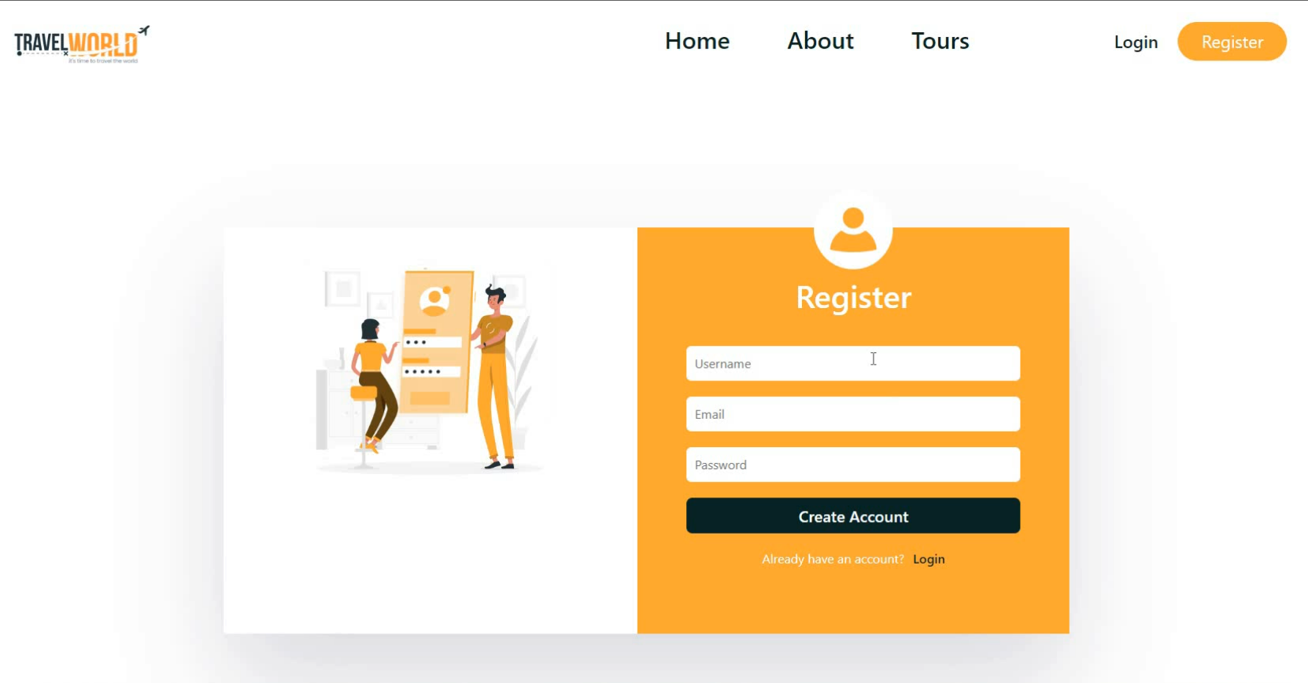
Login & Register

Slide 8
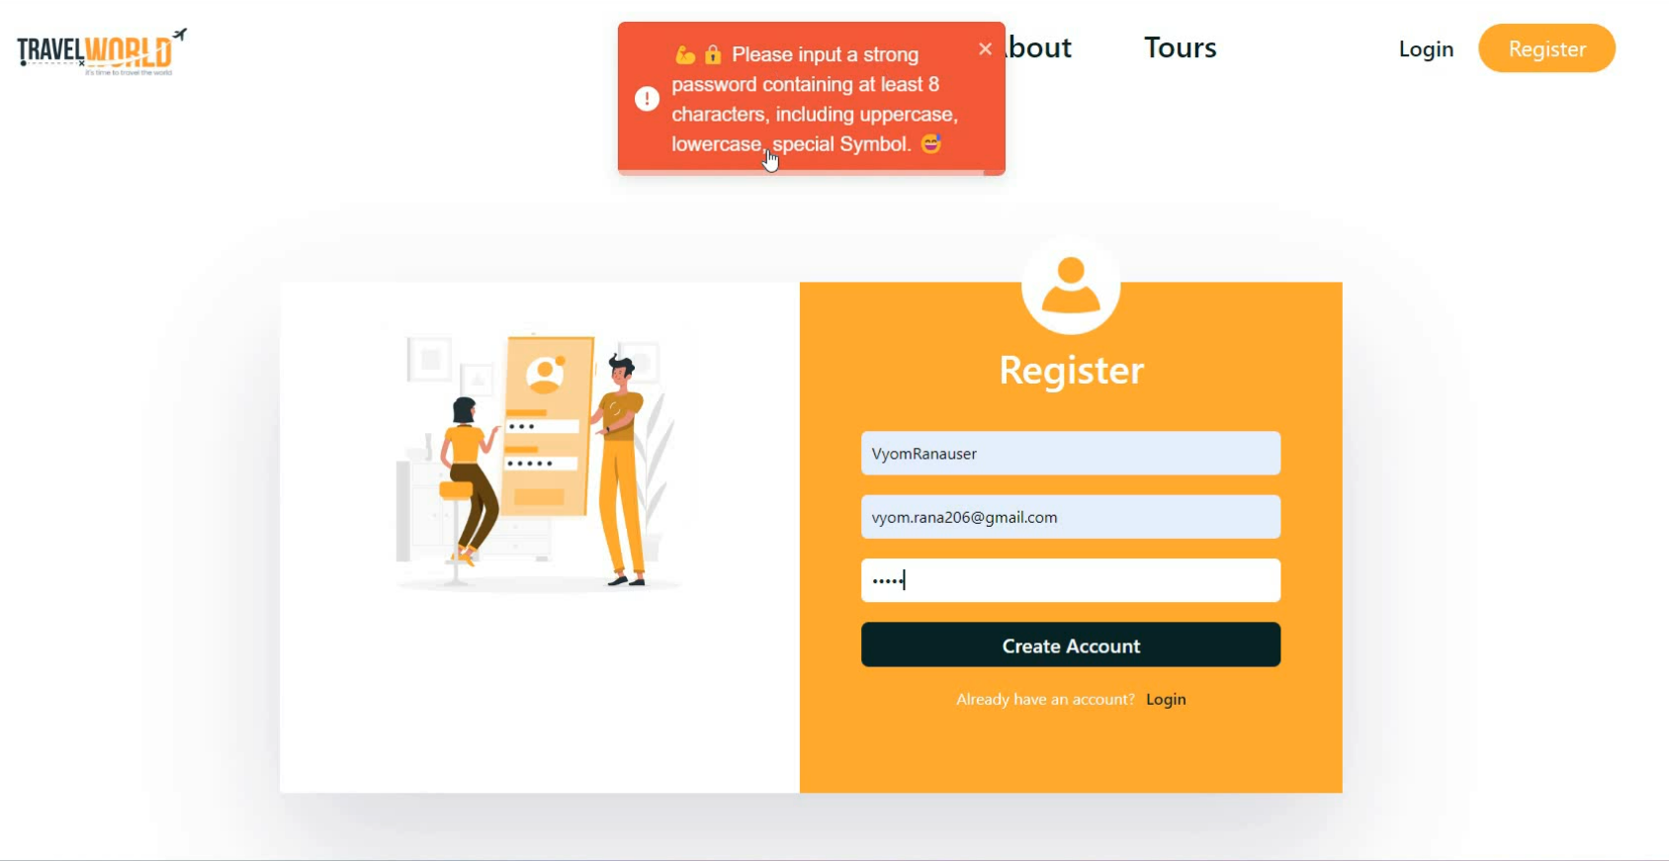
Login & Register(Weak password)

Slide 9
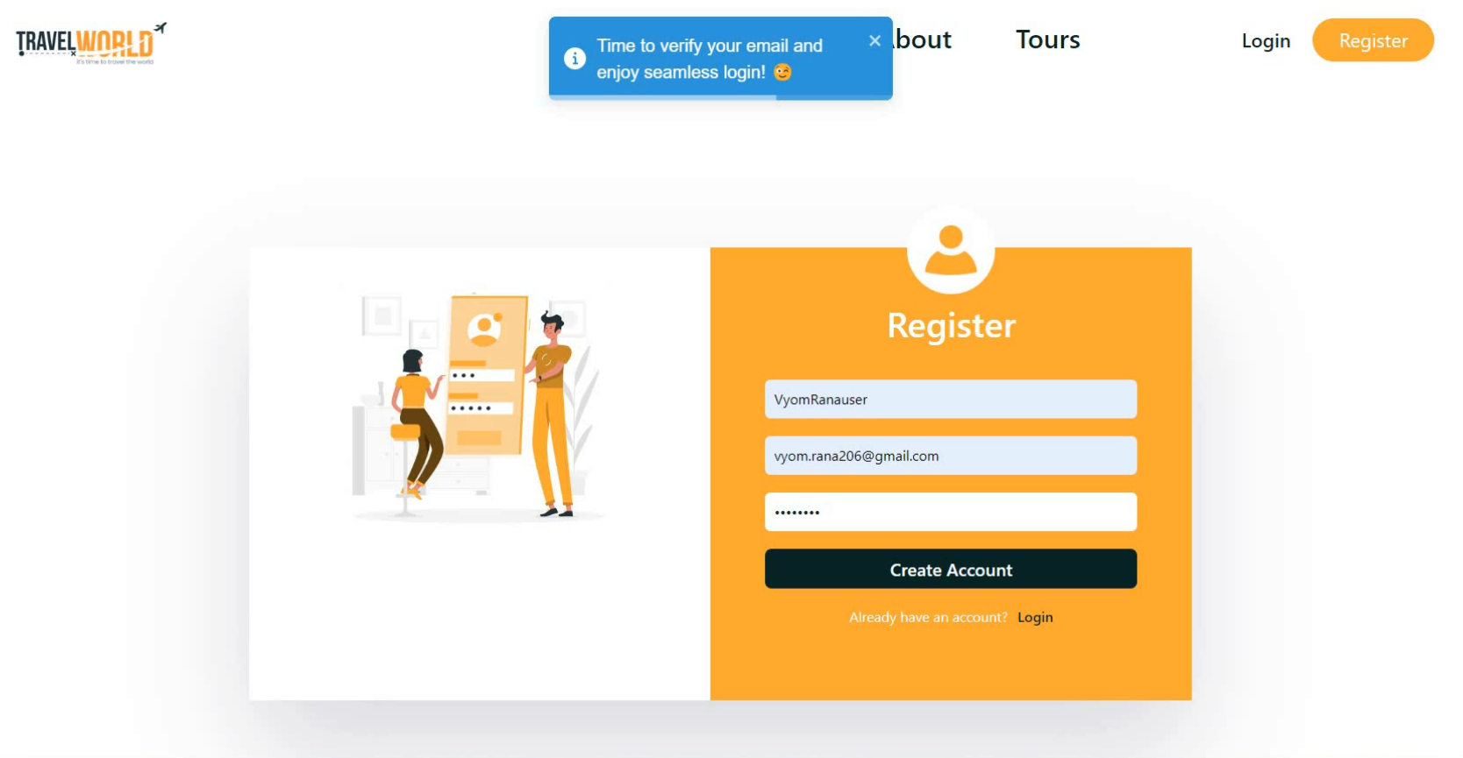
Login & Register(Strong Password)

Slide 10
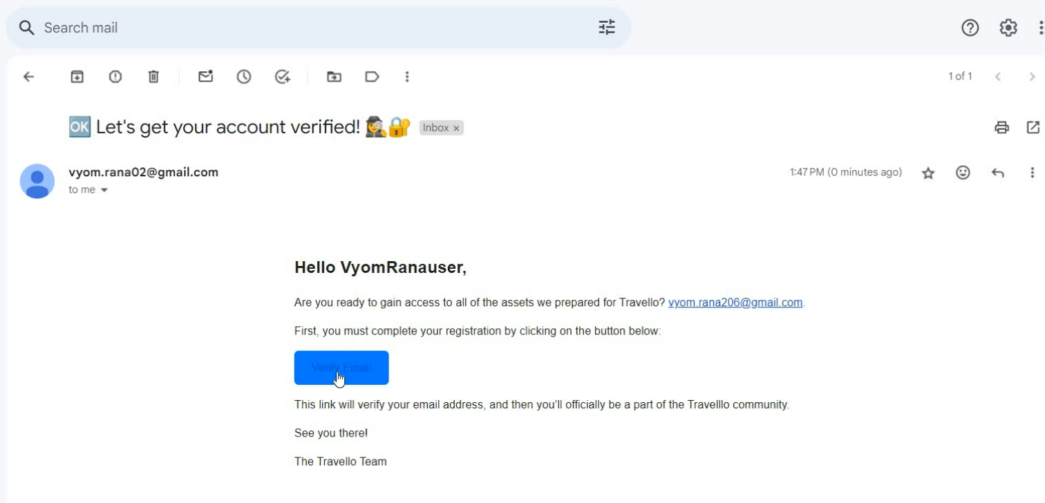
Login & Register(Account Verification)

Slide 11
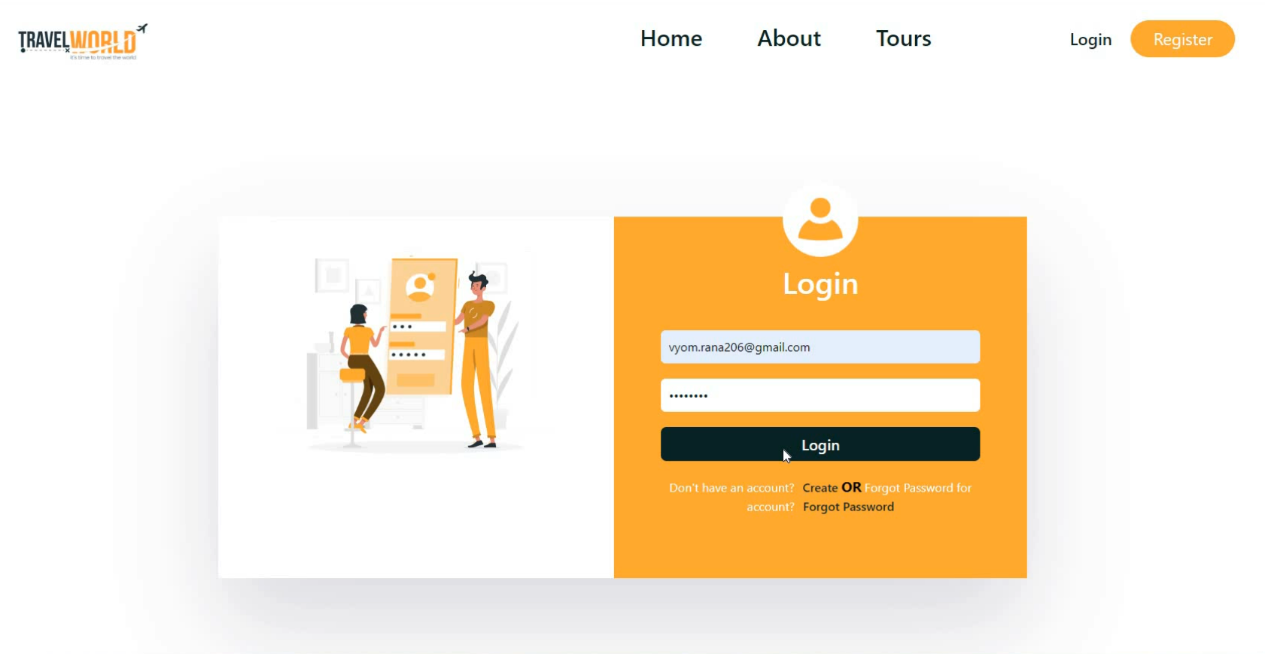
Login & Register(Login with Credentials)

Slide 12
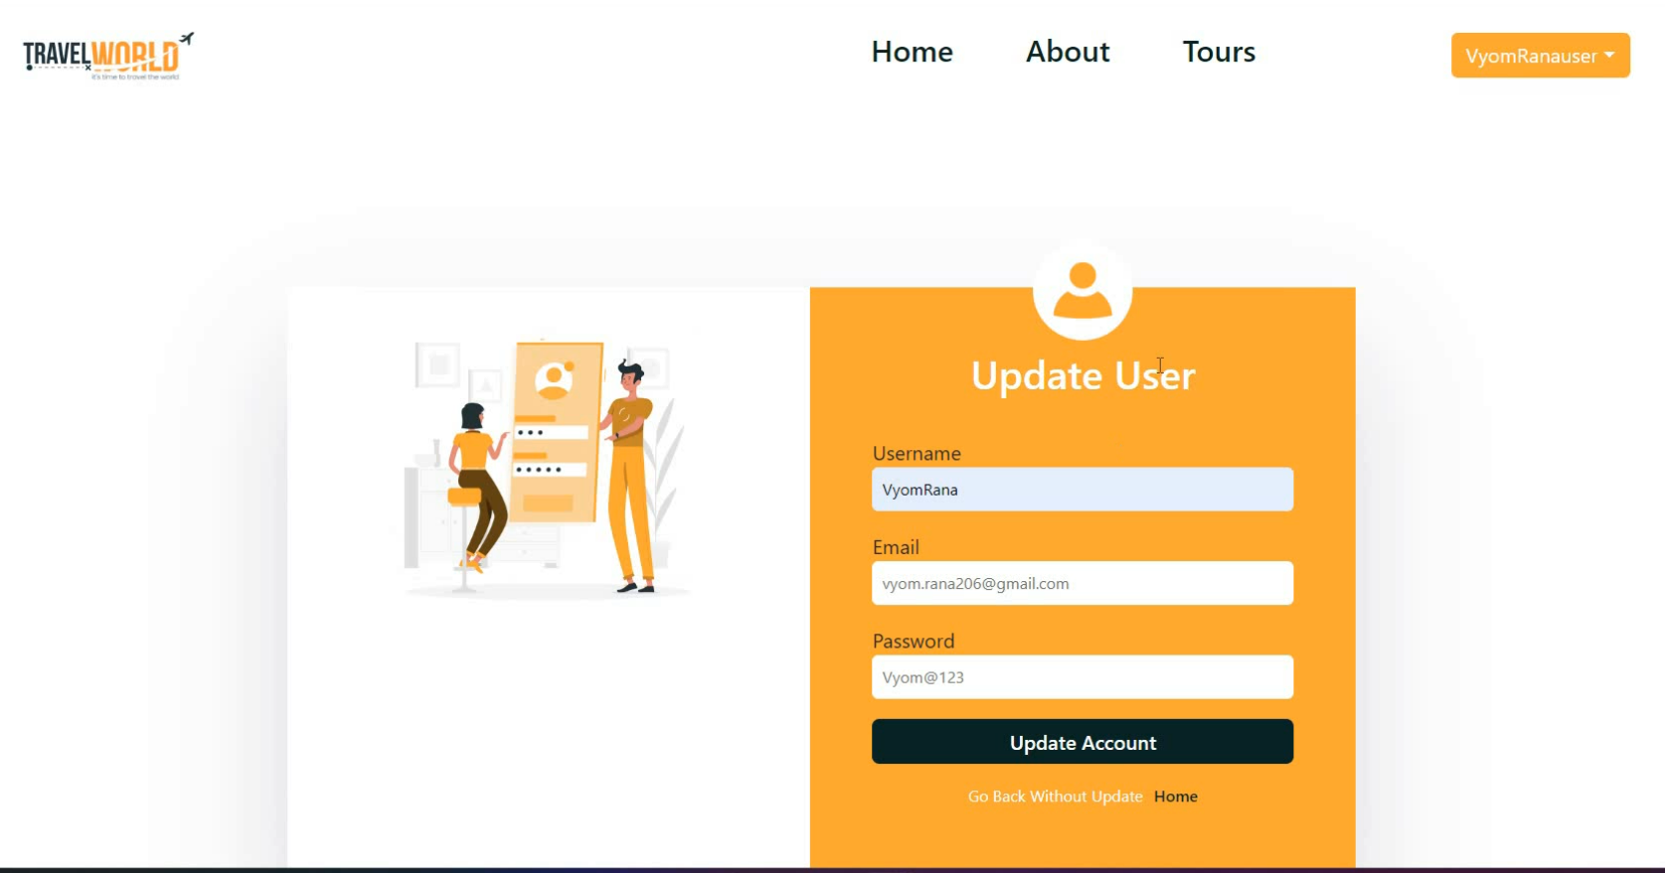
Update Profile

Slide 13
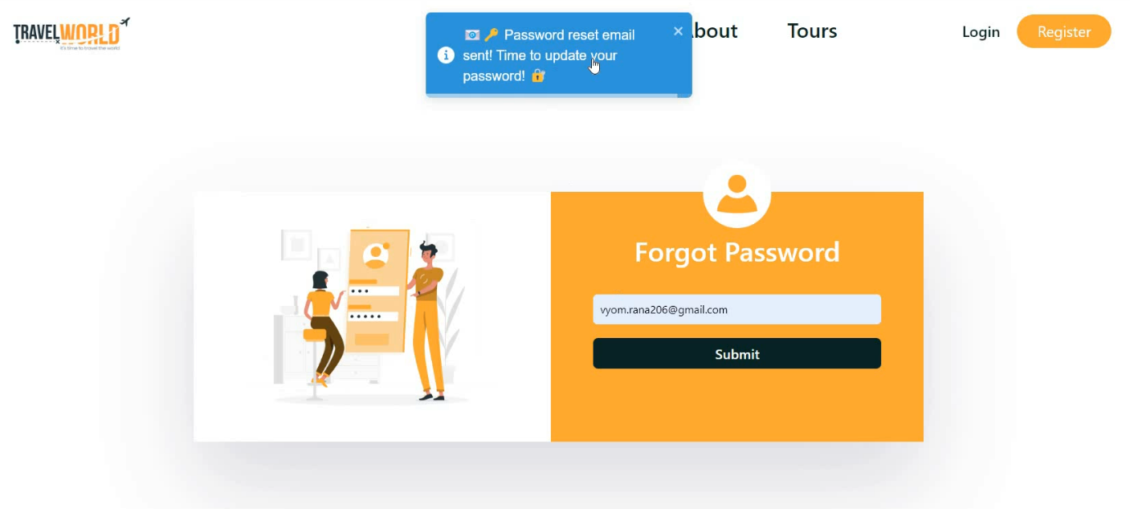
Forgot Password

Slide 14
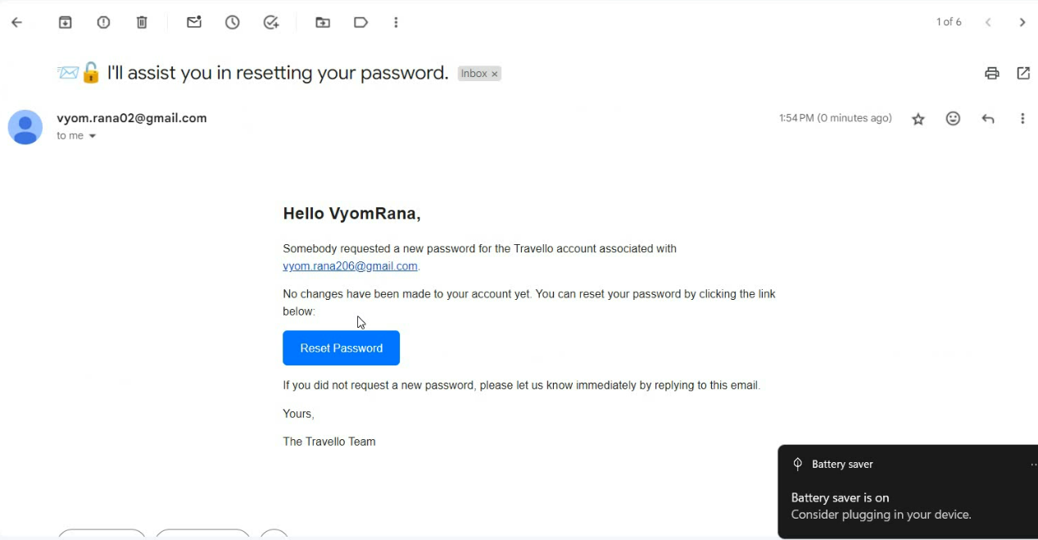
Reset Password (Reset password Email)

Slide 15
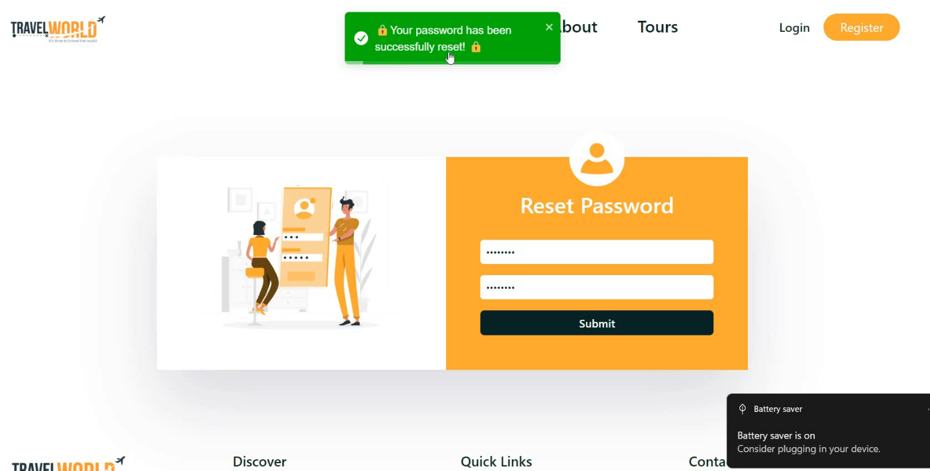
Reset Password

Slide 16
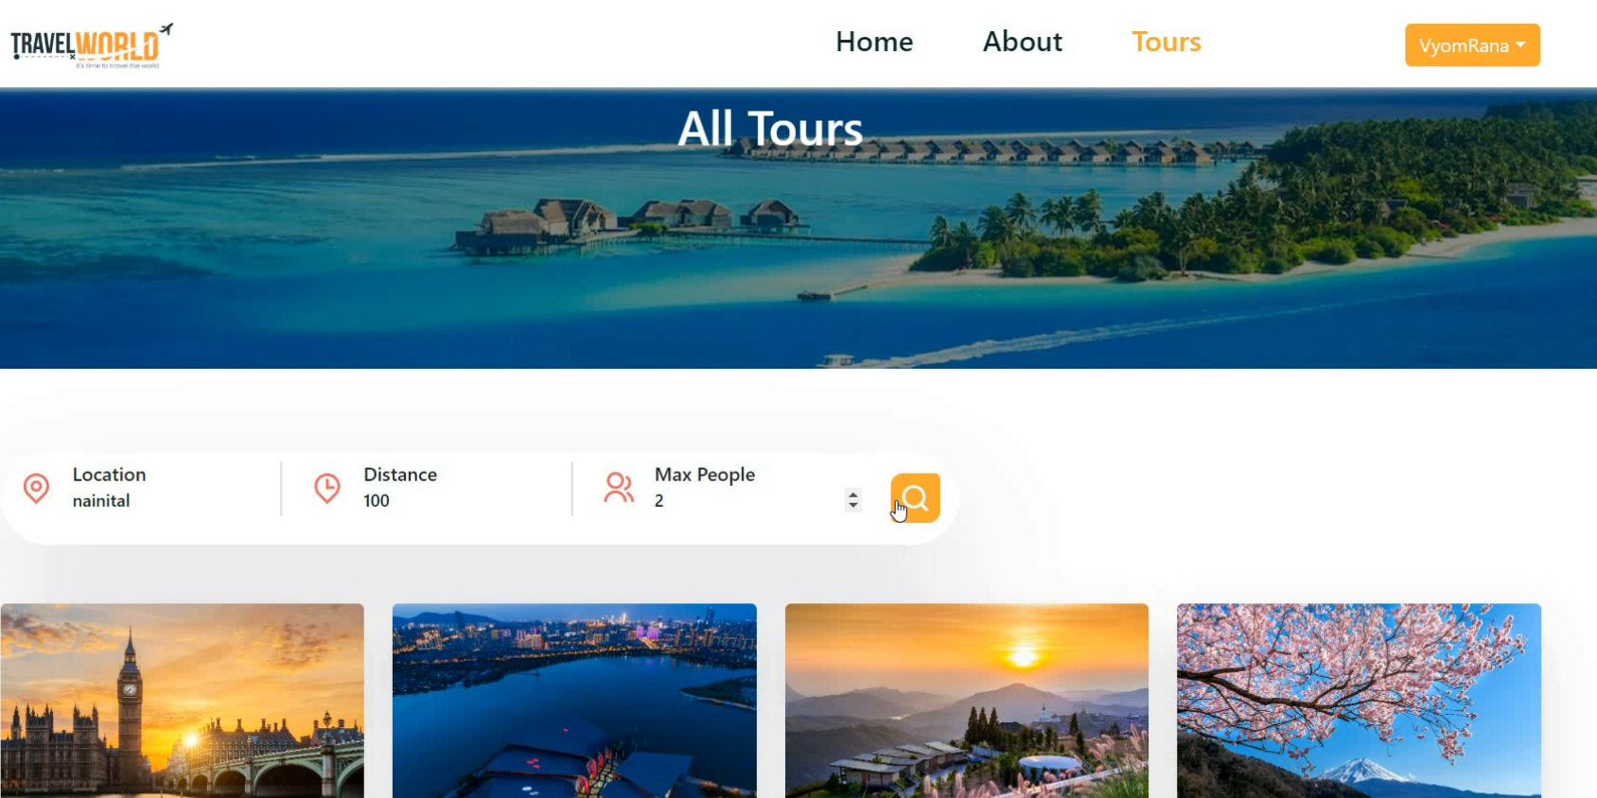
Tour Search

Slide 17
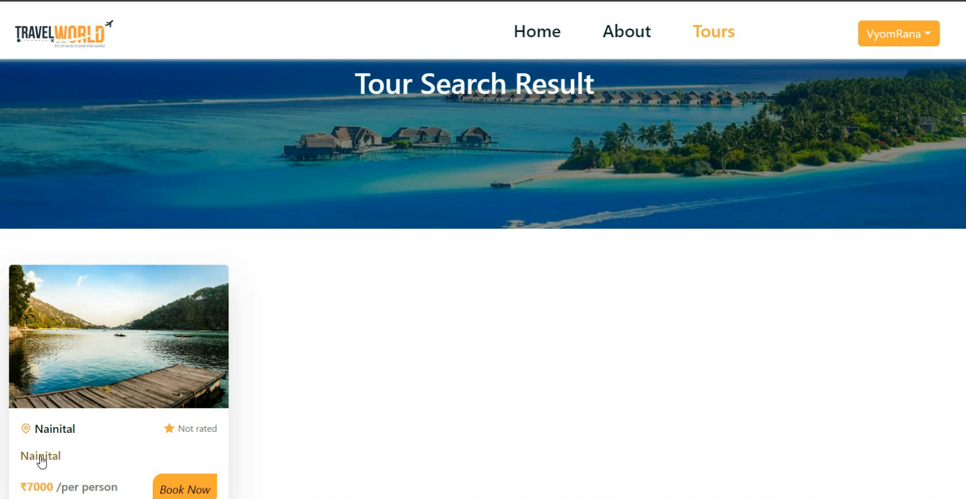
Tour Search(Searching Nainital)

Slide 18
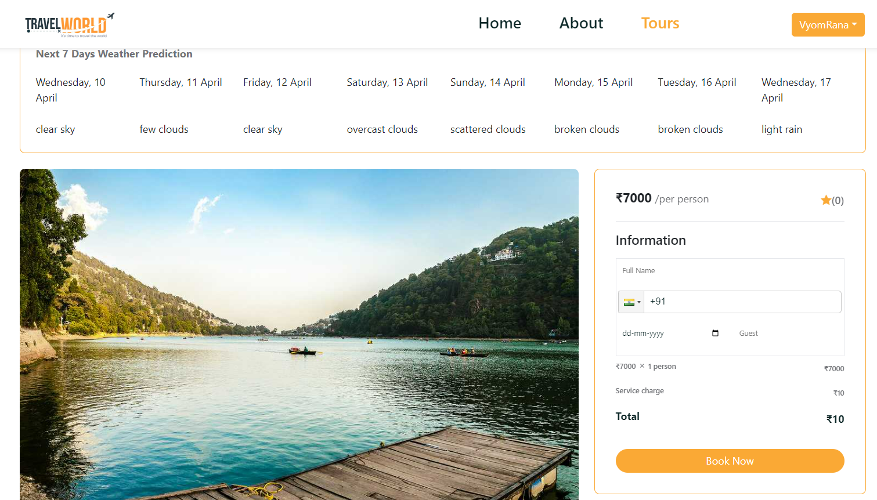
View Weather Prediction of Tour

Slide 19
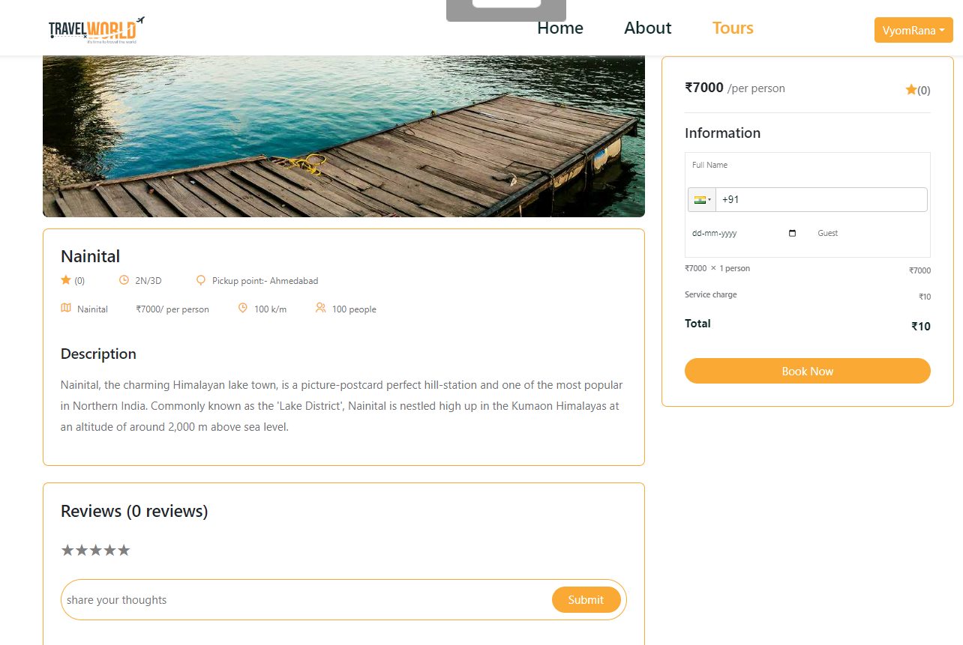
Tour Details(Viewing Tour)

Slide 20
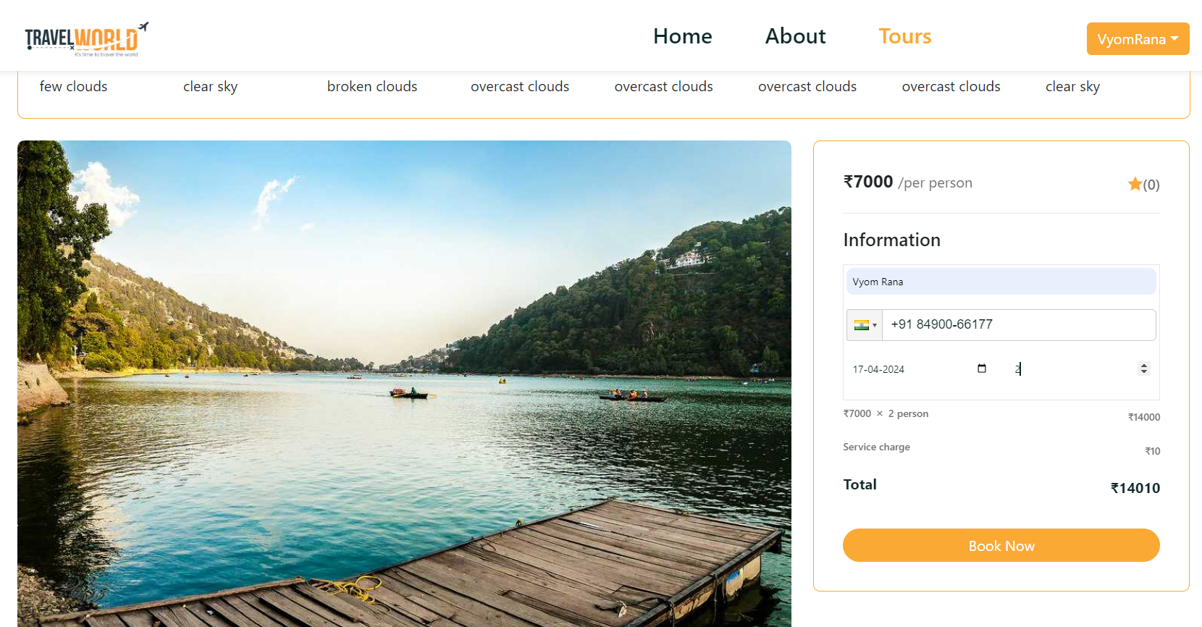
Book Tour(Entering Proper Details)

Slide 21
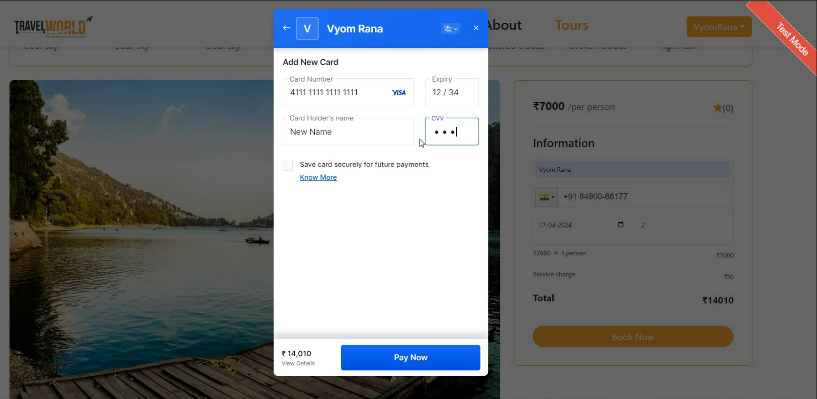
Book Tour(Payment using Card)

Slide 22
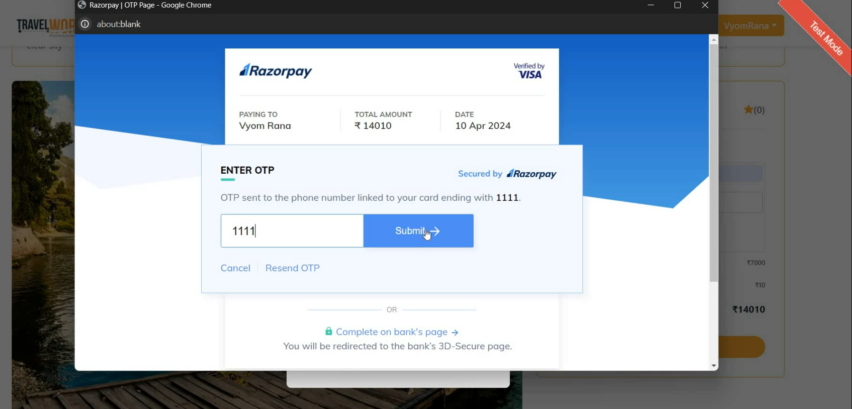
Book Tour(OTP)

Slide 23
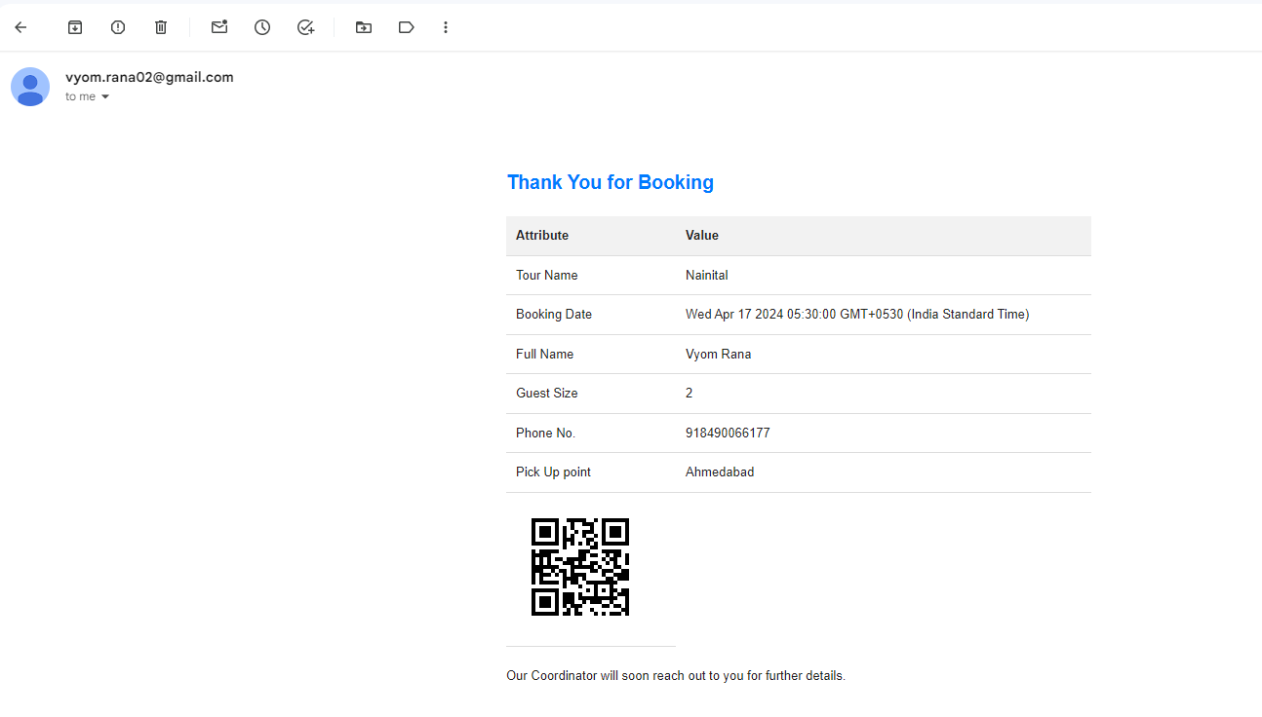
Book Tour(Booking Confirmation Email)

Slide 24
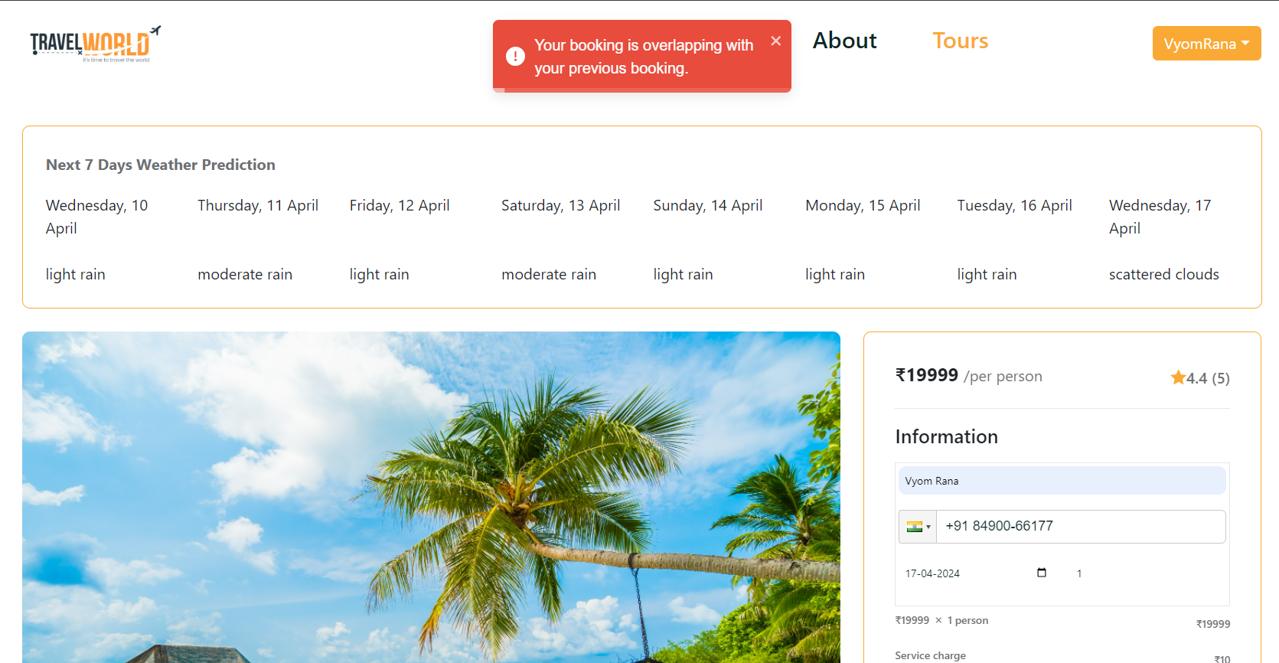
Book Tour(Try Overlapping Booking)

Slide 25
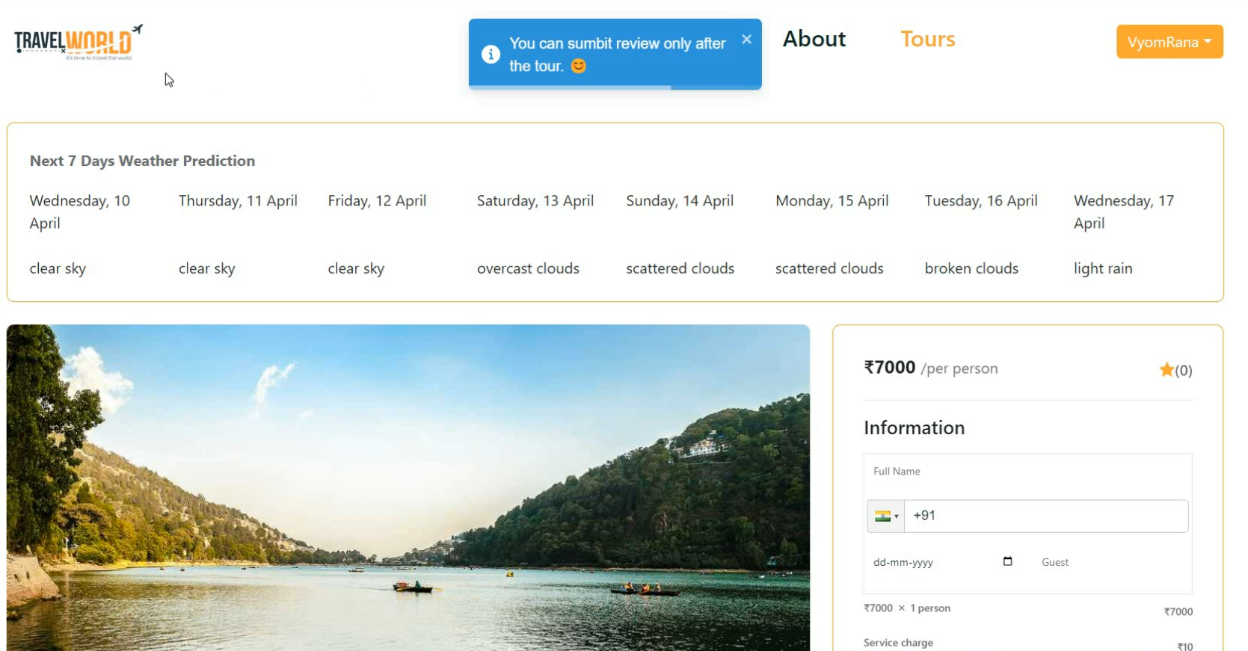
Review Tour(Try Reviewing Tour)

Slide 26
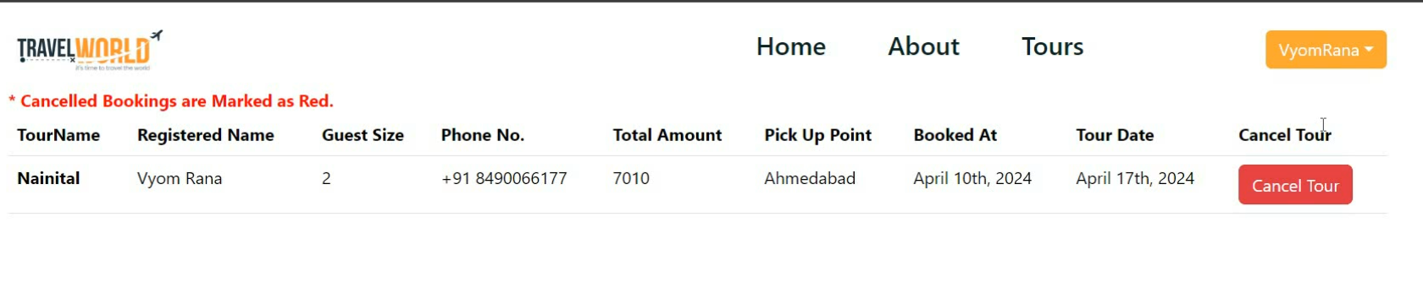
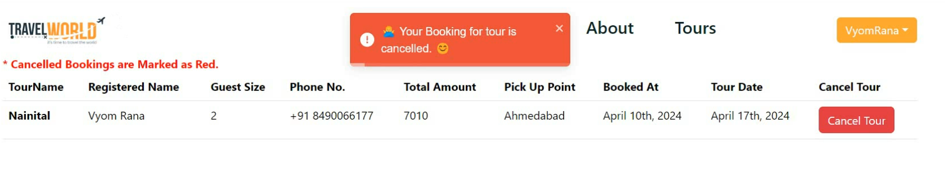
View Prev. Bookings

Slide 27
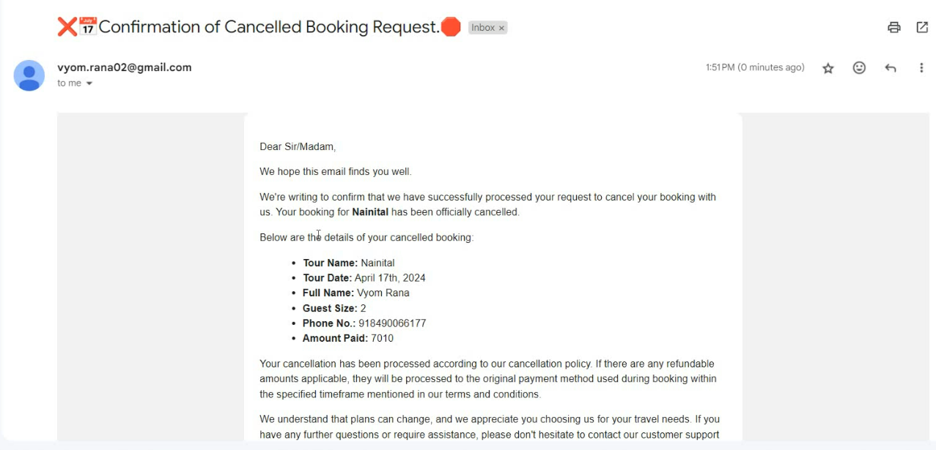
Cancel Booking(Email)

Slide 28
Admin User Functionalities
Add Tour
Update Tour
Delete Tour
Pause/Unpause Tour
User Management
Booking Management

Slide 29
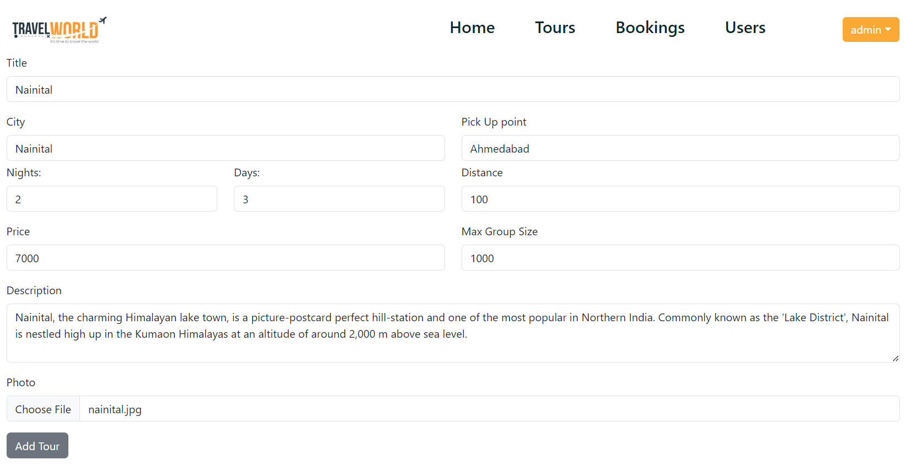
Add Tour

Slide 30
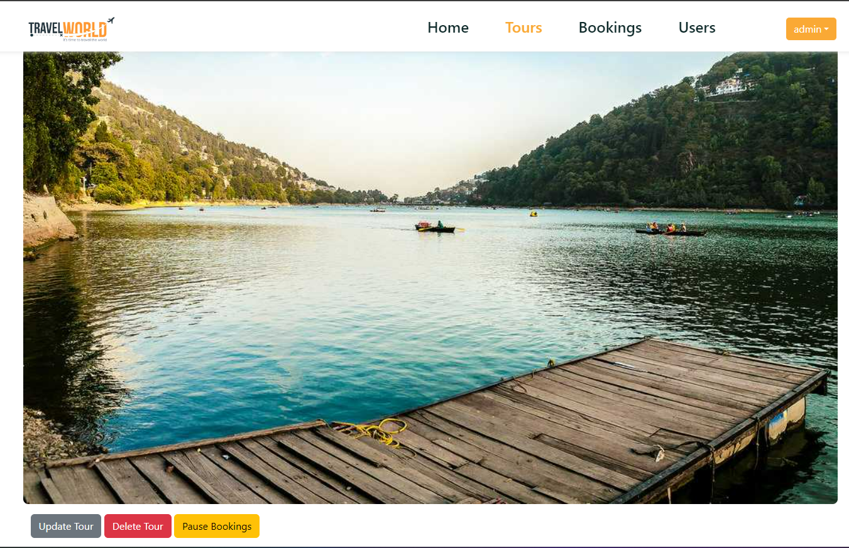
View Tour(Update,Delete, Pause Tour)

Slide 31
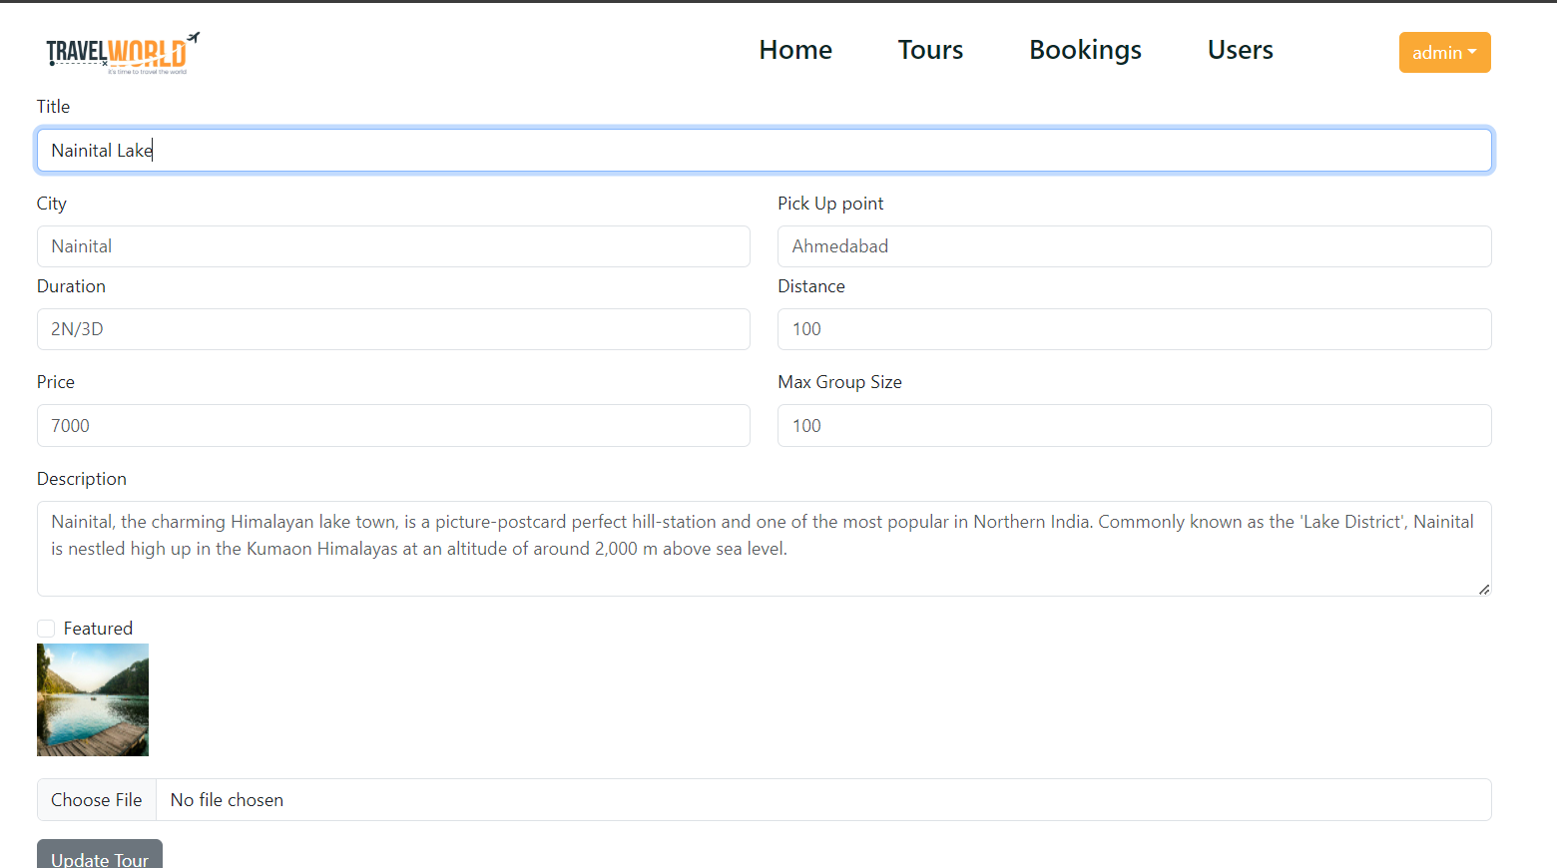
Update Tour(Updating title of Tour)

Slide 32
Pause/Unpause Tour

Slide 33
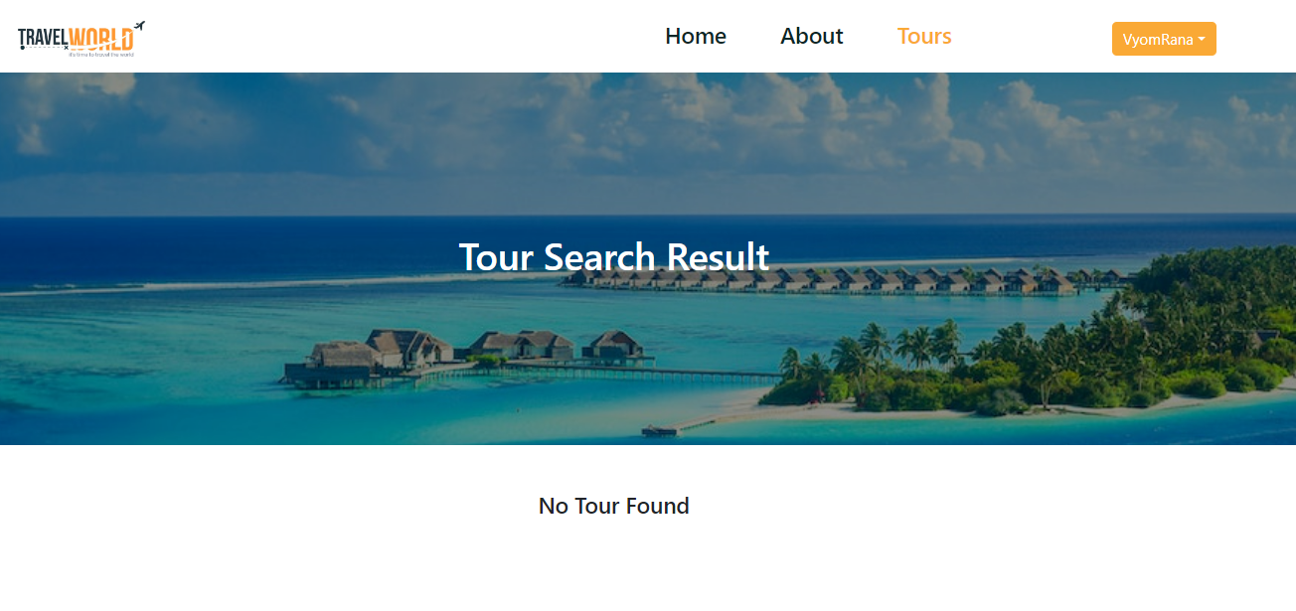
Pause/Unpause Tour(Search “Nainital”)

Slide 34
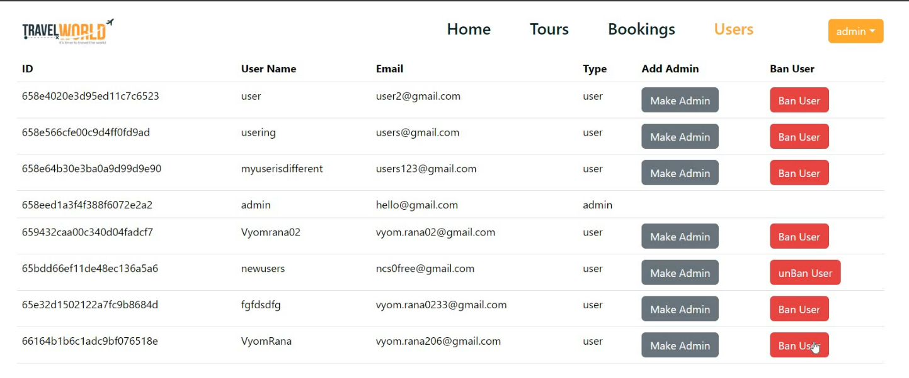
View Users

Slide 35
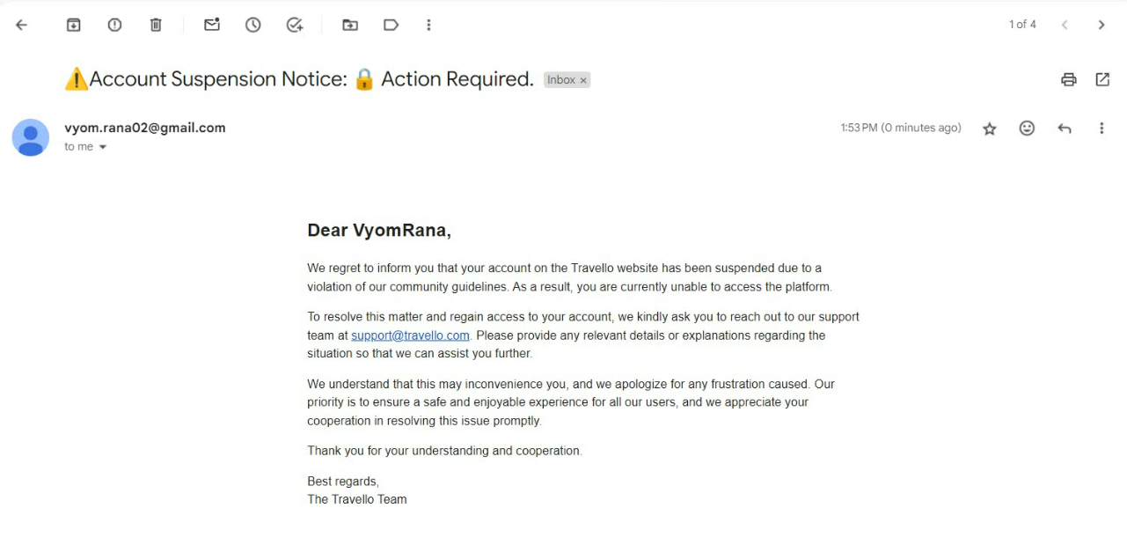
Ban User(Email to Banned User)

Slide 36
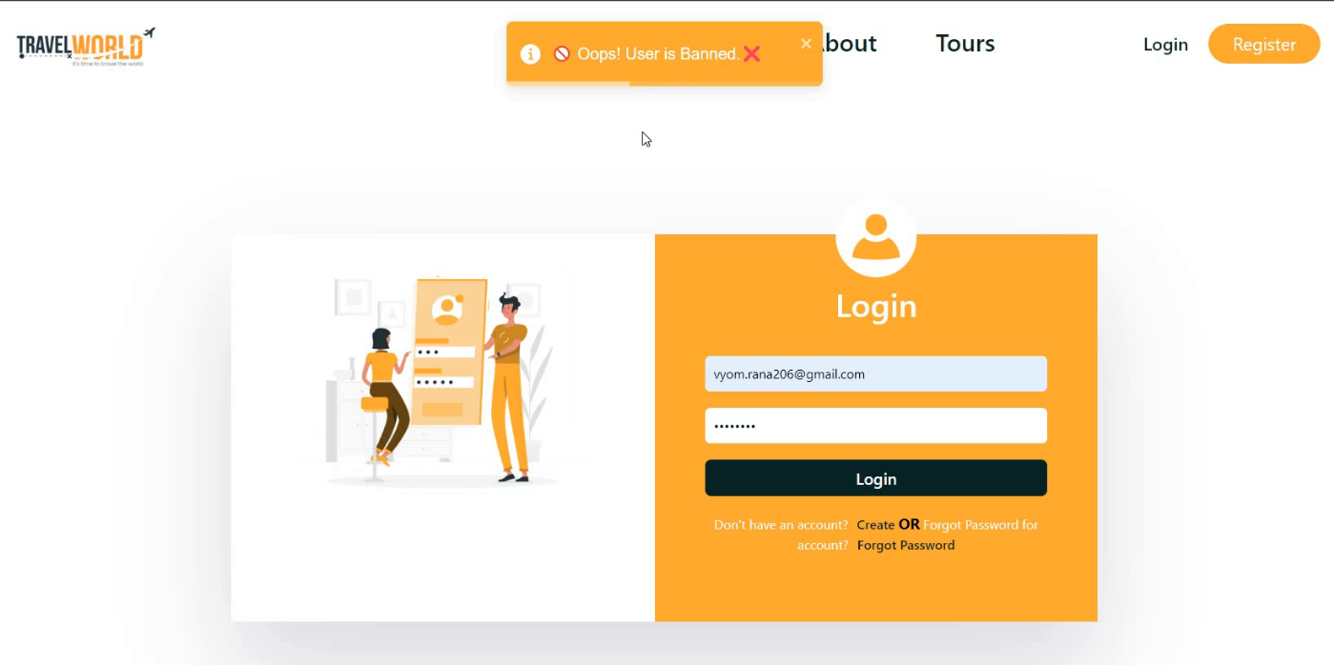
Ban User(Tries Login)

Slide 37
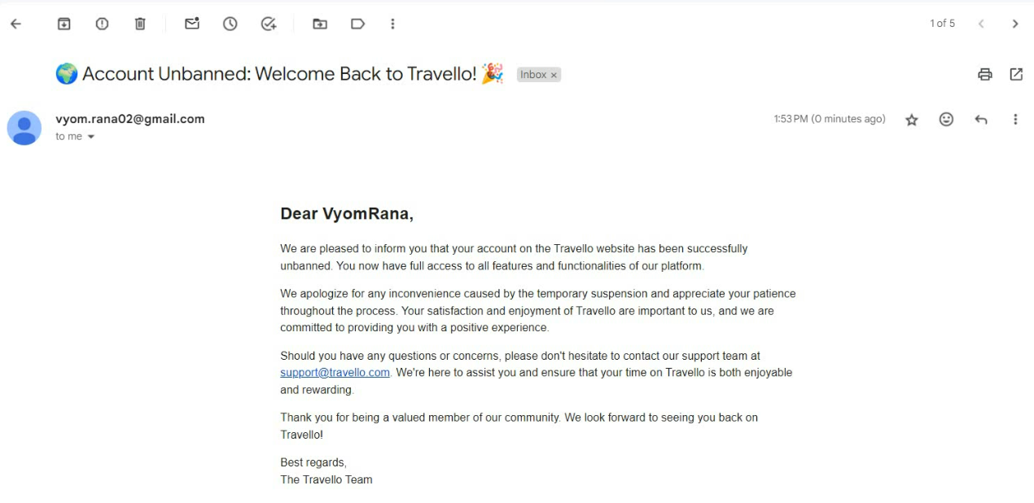
UnBan User(unban Email to Banned User)

Slide 38
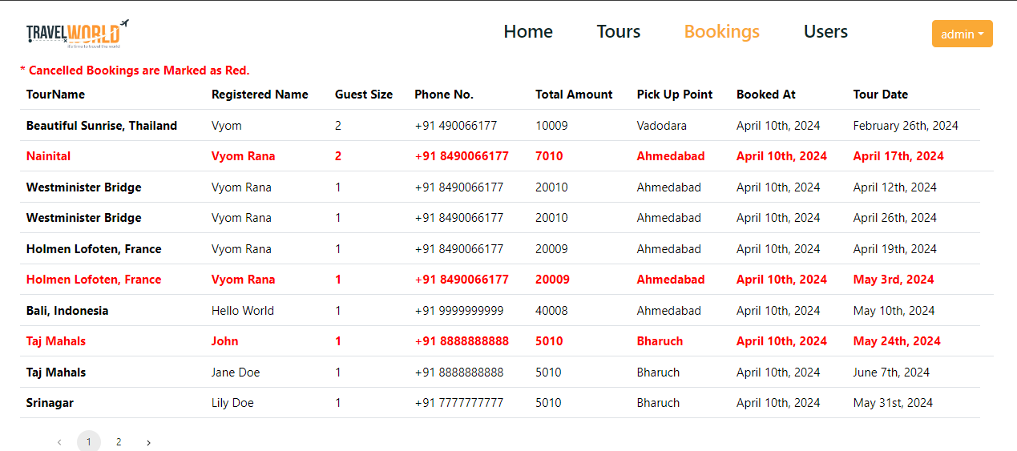
View Bookings

Slide 39
Conclusion
In conclusion, Travello offers a comprehensive solution for online tour booking, catering to both users and administrators. With its advanced features and seamless user experience, Travello aims to revolutionize the way travelers plan and book their tours.

Slide 40
Future Enhancements
Feature Enhancement
Adding tour recommendation system.
Expansion of admin features for better management
Continuous UI/UX improvements based on user feedback.
Multi Language Support
Tech Enhancement.
Disintegrate this app in Microservice app.

Slide 41
Thank You!
Thank you for your attention.
Any questions?

Slide 42
Links and References:-
ReactJS Docs:- https://legacy.reactjs.org/tutorial/tutorial.html
NPM Docs:- https://www.npmjs.com/
MongoDb Docs:- https://www.mongodb.com/
RazorPay Docs:- https://dashboard.razorpay.com/
JWT Docs:- https://jwt.io/
ExpressJS Docs:- https://expressjs.com/en/4x/api.html

Slide 43
My Socials & Site:-
https://www.linkedin.com/in/vyomrana/
https://github.com/Vyomrana02/
https://vyomrana02.github.io/
https://travello-tours-and-travels.onrender.com/

